Slide 1
Python for Business Analytics
Alysson Silveira
October 10, 2023

Slide 2
ANALYSIS CHECKLIST
Data inspection
Summary statistics
Correlations
Plots (Analyzing data distribution)
Missing data
Feature creation
Non-numeric features
Split train and test sets
Model training
Explain, predict, or both.
Evaluation

Slide 3
Data inspection
When inspecting the data
Look for :
Missing data
Non-numeric variables
Most promising variables (features)
Ways to combine features and generate new variables
Data imbalance
Think of the types of business problems you can address with the data

Slide 4
Summary statistics
When analyzing the summary statistics
Look for:
Abnormal values (min, max)
Mean values of key variables
Unexpected values may indicate:
Outliers – they can bias your analysis
Errors in the data acquisition process

Slide 5
Correlations
“Correlation is a statistical measure that expresses the extent to which two variables are linearly related.”
When analyzing the correlations
Look for:
High positive or negative correlations
If you are conducting an explanatory analysis, correlations above 0.9 may bias your results. Drop the highly correlated variables.
Unexpected correlations
Direction
Magnitude

Slide 6
PLOTS
Plot the data
Look for:
(Histogram)
Distribution of your dependent variable (target, y variable)
Distribution of key independent variables
(Scatter plot)
Relationship between key independent and dependent variables

Slide 7
MISSING DATA
Dealing with missing data
Option 1 - Drop the feature (column)
Advised when the proportion of missing observations is > 20%
Option 2 – Drop the observations (rows)
Option 3 – Replace missing values with mean or median

Slide 8
Feature creation
Create new variables
Combine features to generate informative variables
Examples:
Sales per sq. feet
Revenue per sales employee
Etc.

Slide 9
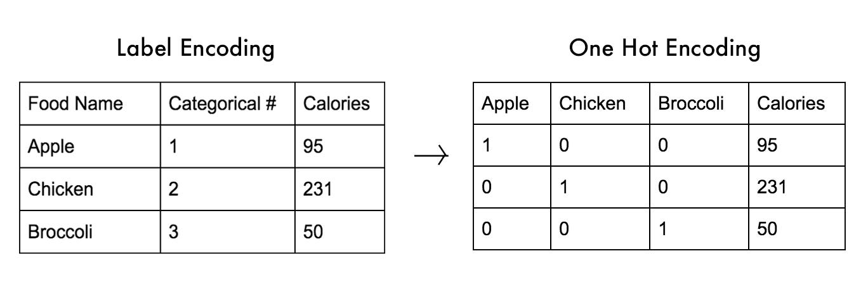
Non-numeric features
Non-numeric data
One hot encoding
Ordinal/Label encoding

Slide 10
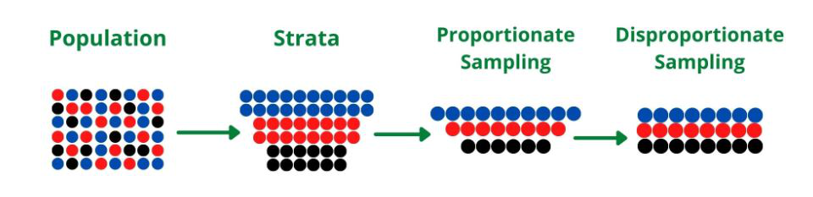
TRAIN & TEST SETS
Train and Test data split
Must be random
Can be stratified
Train dataset is used to train the model (fit the model)
Test dataset is used to evaluate how well the model performs

Slide 11
MODEL TRAINING
Train the model
Using the Train dataset
The X features and the y feature are passed separately
We don’t use the Test set at this stage
Analyze coefficients (diagnostic/explanatory analysis)
Make predictions (predictive analysis)

Slide 12
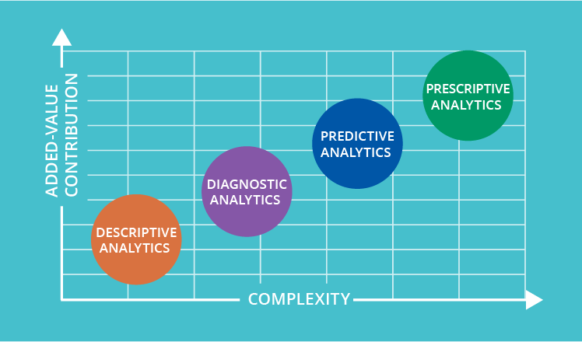
Data preparation
Descriptive, which answers the question, “What happened?”
Diagnostic, which answers the question, “Why did this happen?”
Predictive, which answers the question, “What might happen in the future?”
Prescriptive, which answers the question, “What should we do next?”

Slide 13
evaluation
Evaluation
Metrics
MSE (Mean squared errors)
MAE (Mean absolute errors)
Using train set (in-sample evaluation)
Using test set (out-of-sample evaluation) – Most important

